Slide 1


PYTHON
Lecture 51

Slide 2

Today’s Agenda
Database Programming In Python-II
Steps Needed For Connecting To Oracle From Python
Exploring Connection And Cursor Objects
Executing The SQL Queries
Different Ways Of Fetching The Data

Slide 3
Steps Required For Connecting Python Code To Oracle
Connecting our Python app to any database involves total 6 important steps.
Also remember that these steps will always remain same irrespective of the database we are trying to connect
The only difference will be the change in the name of the module

Slide 4
Steps Required For Connecting Python Code To Oracle
For connecting to Oracle , the steps are:
Import the module cx_Oracle
Establish a connection to the database.
Create a cursor to communicate with the database.
Execute the SQL query
Fetch the result returned by the SQL query
Close the cursor and connection to the database.

Slide 5
Step 1- Importing The Module
Since we are connecting to Oracle , so all the functions and classes we will be using will be supplied by the module called cx_Oracle.
So the first step will be to import this module by writing the following statement:
import cx_Oracle

Slide 6
Step 2- Establishing The Connection
After importing the module ,we must open the connection to the Oracle server.
This can be done by calling the function connect( ) of cx_Oracle module having the following syntax:
cx_Oracle.connect( “connection_details”)
Following is the description of this function:
It accepts a connection string as argument of the following format “username/password@ipaddress/oracle_service_name”
If a connection is established with the Oracle server, then a Connection object is returned.
If there is any problem in connecting to the database , then this function throws the exception called cx_Oracle.DatabaseError

Slide 7
Important Attributes/Methods Of Connection Object
When the connection is successful , we get back the cx_Oracle.Connection object.
This object holds complete details of the connection and we can get these details by calling it’s attributes or methods.
Following are it’s important attributes:
username: Returns the username used for the connection
version: Returns Oracle version number
Following are it’s important methods:
cursor() : Return a new Cursor object using the connection.
close(): Closes the connection
commit(): Commits any pending transactions to the database.
rollback(): Rollbacks any pending transactions.

Slide 8
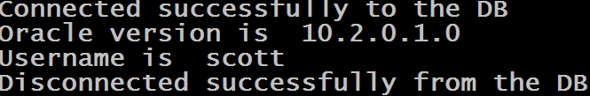
Example
import cx_Oracle
conn=None
try:
conn=cx_Oracle.connect("scott/tiger@127.0.0.1/orcl")
print("Connected successfully to the DB")
print("Oracle version is ",conn.version)
print("Username is ",conn.username)
except (cx_Oracle.DatabaseError)as ex:
print("Error in connecting to Oracle:",ex)
finally:
if conn is not None:
conn.close()
print("Disconnected successfully from the DB")
Output:

Slide 9
Step 3- Creating The Cursor
Once we have a connection, we need to get a cursor
A Cursor allows us to send all the SQL commands from our Python code to the database.
It can also hold the set of rows returned by the query and lets us work with the records in that set, in sequence, one at a time.
To get a Cursor object we call the method cursor( ) of the Connection object as follows:
cur=conn.cursor()

Slide 10
Important Attributes/Methods Of Cursor Object
A Cursor object provides us some attributes and methods to execute the SQL query and get back the results
Following are it’s important attributes:
rowcount: Returns the number of rows fetched or affected by the last operation, or -1 if the module is unable to determine this value.
Following are it’s important methods:
execute(statement) : Executes an SQL statement string on the DB
fetchall(): Returns all remaining result rows from the last query as a sequence of tuples
fetchone(): Returns the next result row from the last query as a tuple
fetchmany(n): Returns up to n remaining result rows from the last query as a sequence of tuples.
close(): Closes the cursor

Slide 11
Step 4- The execute( ) Method
Syntax:
execute(SQL statement, [parameters], **kwargs)
This method can accept an SQL statement - to be run directly against the database. It executes this SQL query and stores the result back in the calling cursor object.
For example:
cur.execute('select * from allbooks')

Slide 12
The execute( ) Method
It can also accept Bind variables assigned through the parameters or keyword arguments.
We will discuss this later

Slide 13
Step 5- Fetching The Result
Once we have executed the SELECT query , we would like to retrieve the rows returned by it.
There are numerous ways to do this:
By iterating directly over the Cursor object
By calling the method fetchone()
By calling the method fetchall()
We will discuss each of these methods after step 6

Slide 14
Step 6- Fetching The Result
The final step will be to close the cursor as well as close the connection to the database once we are done with processing.
This is done by calling the method close() on both the objects.
Example:
cur.close()
conn.close()

Slide 15
An Important Point!
During communication with Oracle , if any problem occurs the methods of the module cx_Oracle throw an exception called DatabaseError.
So it is a best practice to execute cx_Oracle methods that access the database within a try..except structure in order to catch and report any exceptions that they might throw.

Slide 16
Directly Iterating Over The Cursor
The Cursor object holds all the rows it retrieved from the database as tuples.
So if we iterate over the Cursor object using the for loop , then we can retrieve these rows

Slide 17
Exercise
Assume you have a table called All_books in the database which contains 4 columns called bookid, bookname, bookprice and subject.
Write a Python code to do the following:
Connect to the database
Execute the query to select name of the book and it’s price from the table Allbooks
Display the records

Slide 18
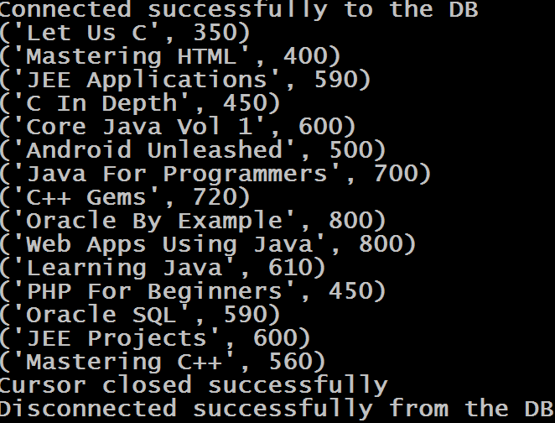
Sample Output

Slide 19
Solution
import cx_Oracle
conn=None
cur=None
try:
conn=cx_Oracle.connect("scott/tiger@Sachin-PC/orcl")
print("Connected successfully to the DB")
cur=conn.cursor()
cur.execute("Select bookname,bookprice from allbooks")
for x in cur:
print(x)
except (cx_Oracle.DatabaseError)as ex:
print("Error in connecting to Oracle:",ex)
finally:
if cur is not None:
cur.close()
print("Cursor closed successfully")
if conn is not None:
conn.close()
print("Disconnected successfully from the DB"

Slide 20
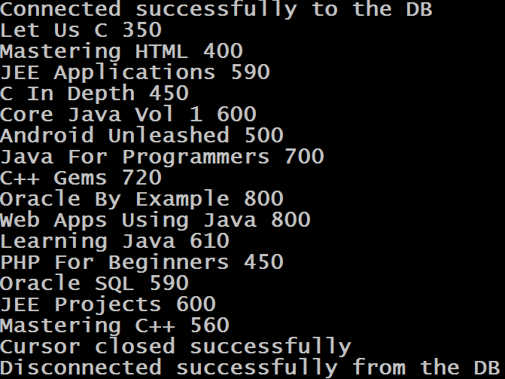
Exercise
Modify the code so that values are displayed without tuple symbol i.e. without the symbol of ( )
Sample Output

Slide 21
Solution
We will just have to unpack each row of the tuple to get the individual values
import cx_Oracle
conn=None
cur=None
try:
conn=cx_Oracle.connect("scott/tiger@Sachin-PC/orcl")
print("Connected successfully to the DB")
cur=conn.cursor()
cur.execute("Select bookname,bookprice from allbooks")
for name,price in cur:
print(name,price)
except (cx_Oracle.DatabaseError)as ex:
print("Error in connecting to Oracle:",ex)
finally:
if cur is not None:
cur.close()
print("Cursor closed successfully")
if conn is not None:
conn.close()
print("Disconnected successfully from the DB"

Slide 22
Using The Method fetchone( )
Sometimes we may want to pull just one record at a time from the table .
As a result Cursor object provides us a method called fetchone( ) .
This method returns one record as a tuple, and if there are no more records then it returns None

Slide 23
Exercise
Modify the previous code to display the name and price of the costliest book from the table Allbooks

Slide 24
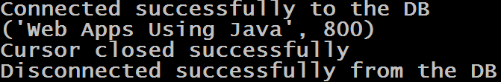
Sample Output

Slide 25
Solution
import cx_Oracle
conn=None
cur=None
try:
conn=cx_Oracle.connect("scott/tiger@Sachin-PC/orcl")
print("Connected successfully to the DB")
cur=conn.cursor()
cur.execute("Select bookname,bookprice from allbooks order by bookprice desc")
x=cur.fetchone()
if x is not None:
print(x)
except (cx_Oracle.DatabaseError)as ex:
print("Error in connecting to Oracle:",ex)
finally:
if cur is not None:
cur.close()
print("Cursor closed successfully")
if conn is not None:
conn.close()
print("Disconnected successfully from the DB")

Slide 26
Exercise
The previous code will only show first costliest book. In other words , suppose we have more than one costliest book then the previous code will only show the first book .
Make the necessary changes in the code so that it shows all the books which are at the highest price level

Slide 27
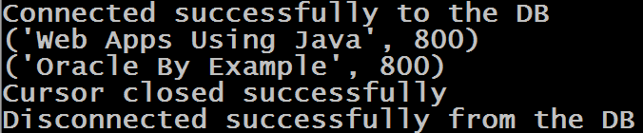
Sample Output

Slide 28
Solution
# code before try same as previous
try:
conn=cx_Oracle.connect("scott/tiger@Sachin-PC/orcl")
print("Connected successfully to the DB")
cur=conn.cursor()
cur.execute("Select bookname,bookprice from allbooks order by bookprice desc")
x=cur.fetchone()
price=x[1]
while True:
if price==x[1]:
print(x)
else:
break
x=cur.fetchone()
except (cx_Oracle.DatabaseError)as ex:
print("Error in connecting to Oracle:",ex)
# code after finally same as previous

Slide 29
Using The Method fetchall( )
Syntax:
cur.fetchall()
The method fetches all rows of a query result set and returns it as a list of tuples.
If no more rows are available, it returns an empty list.

Slide 30
Sample Code
import cx_Oracle
conn=None
cur=None
try:
conn=cx_Oracle.connect("scott/tiger@Sachin-PC/orcl")
print("Connected successfully to the DB")
cur=conn.cursor()
cur.execute("Select bookname,bookprice from allbooks order by bookprice desc")
x=cur.fetchall()
print(x)
except (cx_Oracle.DatabaseError)as ex:
print("Error in connecting to Oracle:",ex)
finally:
if cur is not None:
cur.close()
print("Cursor closed successfully")
if conn is not None:
conn.close()
print("Disconnected successfully from the DB")

Slide 31
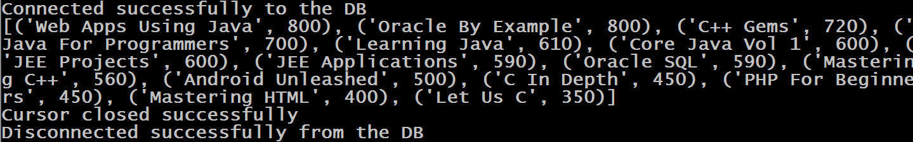
Output

Slide 32
Exercise
Modify the previous book application so that your code asks the user to enter a record number and displays only that book .
Make sure if the record number entered by the user is wrong then display appropriate message using exception handling

Slide 33
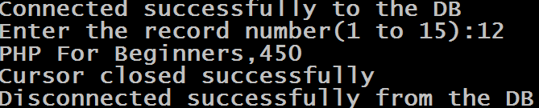
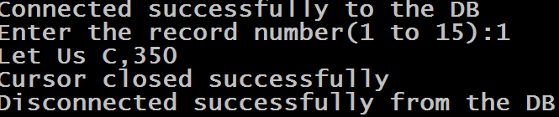
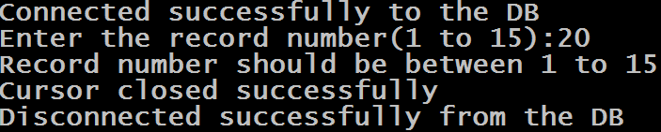
Output

Slide 34
Solution
import cx_Oracle
conn=None
cur=None
try:
conn=cx_Oracle.connect("scott/tiger@Sachin-PC/orcl")
print("Connected successfully to the DB")
cur=conn.cursor()
cur.execute("Select bookname,bookprice from allbooks")
booklist=cur.fetchall()
recnum=int(input(f"Enter the record number(1 to {len(booklist)}):"))

Slide 35
Solution
if recnum <1 or recnum>len(booklist):
raise Exception(f"Record number should be between 1 to {len(booklist)}")
else:
row=booklist[recnum-1]
print(f"{row[0]},{row[1]}")
except (cx_Oracle.DatabaseError)as ex:
print("Error in connecting to Oracle:",ex)
except (Exception) as ex:
print(ex)
finally:
if cur is not None:
cur.close()
print("Cursor closed successfully")
if conn is not None:
conn.close()
print("Disconnected successfully from the DB")

